Slide 1
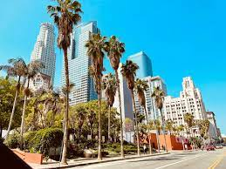
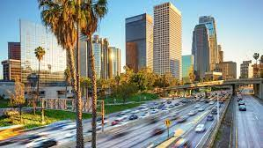
Travel Around USC
Annabeth Wu, Ted Ao
Simon Yan, Tiantian Bai

Slide 2
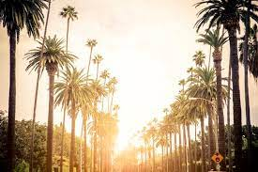
CONTENTS
01
BASIC INFORMATION ABOUT LA
APPS FOR REFERENCE
02
PLACES TO VISIT
03

Slide 3
01
BASIC INFORMATION ABOUT LA
1.Climate
2.Transportation
3.Arts & Culture

Slide 4
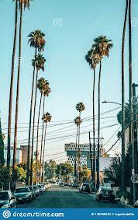
Basic Info
Climate
usually sunny & warm
average temperature 17-22 degrees Celsius for May - July
Transportation
subways, light-rail, buses and shuttles
The LA Metro Rail System
Los Angeles Union Station
Cruises
Arts & Culture
more museums than any other city
world-class theaters and art institutions

Slide 5
02
APPs for Reference

Slide 6

APP
TripAdvisor
Travel information about hotels and resorts.
Reviews
Photographs
Informative Forums

Slide 7

APP
Booking
Travel agency offering lodging reservation services.
Hotels
Motels
Resorts
Homes

Slide 8


APP
Lyft & Uber
Ride-sharing services
Access a driver nearby!

Slide 9
03
Places to Visit

Slide 10
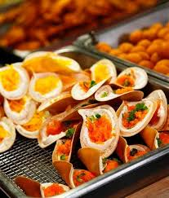
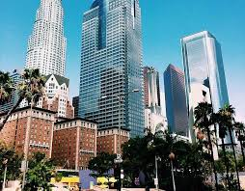
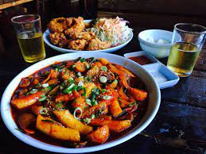

Six Taste
Sampling food + Learning local history
Largest and highest-rated tour company
Historical and cultural sights
Downtown LA, Santa Monica, Hollywood……
LA food scene + diverse array of cultures

Slide 11
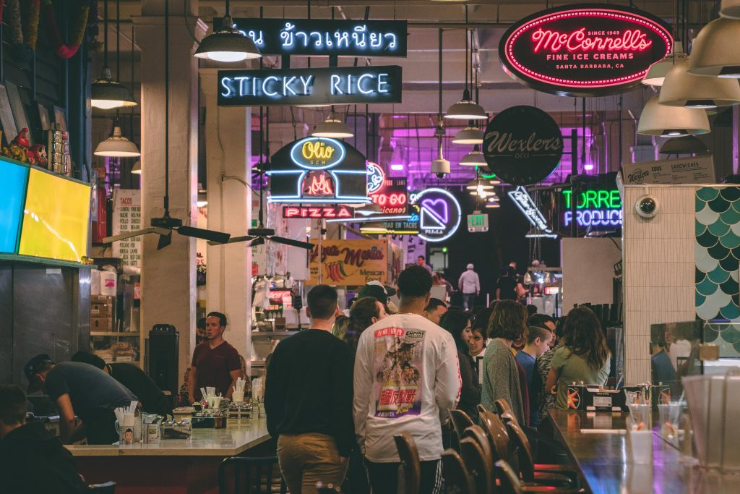
Downtown Los Angeles Food Tour
LA: Dynamic Food Culture
Foodie-friendly Walking Tour

Slide 12
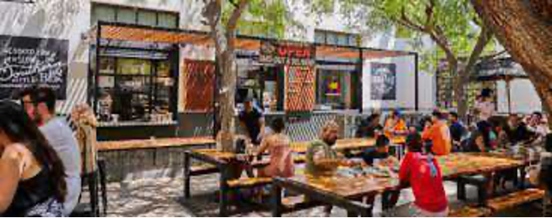
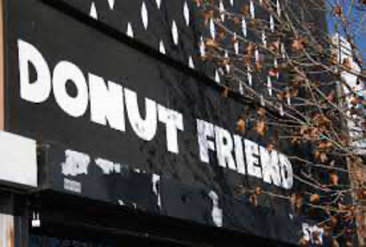
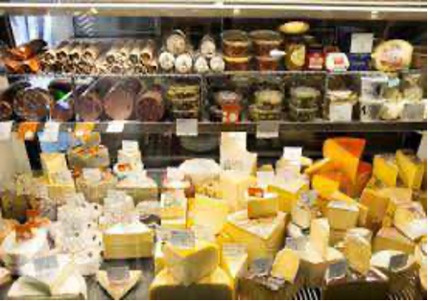
Downtown Los Angeles Food Tour
Grand Central Market
Duration: 25min
Horse Thief BBQ
Duration: 20min
Donut Friend DTLA
Duration: 20min
DTLA Cheese
Duration: 20min

Slide 13
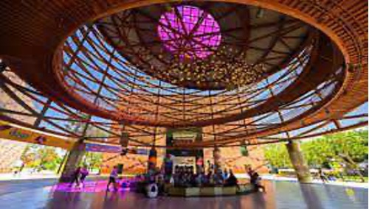
California Science Center
Opened in Exposition Park in Los Angeles in 1912
The Science Center is open to the public 7 days a week, 362 days per year, with free general admission to its four major exhibit areas.

Slide 14
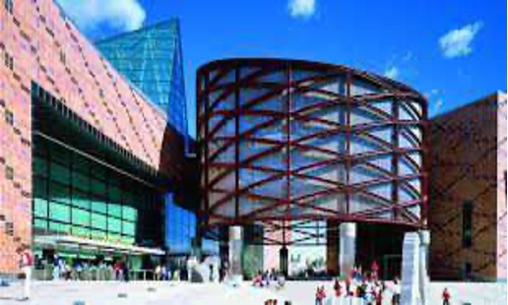
California Science Center
The California Science Center aspires to stimulate curiosity and inspire science learning in everyone by creating fun, memorable experiences, because they value science as an indispensable tool for understanding the world, accessibility and inclusiveness, and enriching people’s lives.

Slide 15
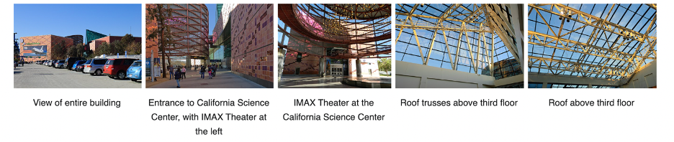
California Science Center

Slide 16
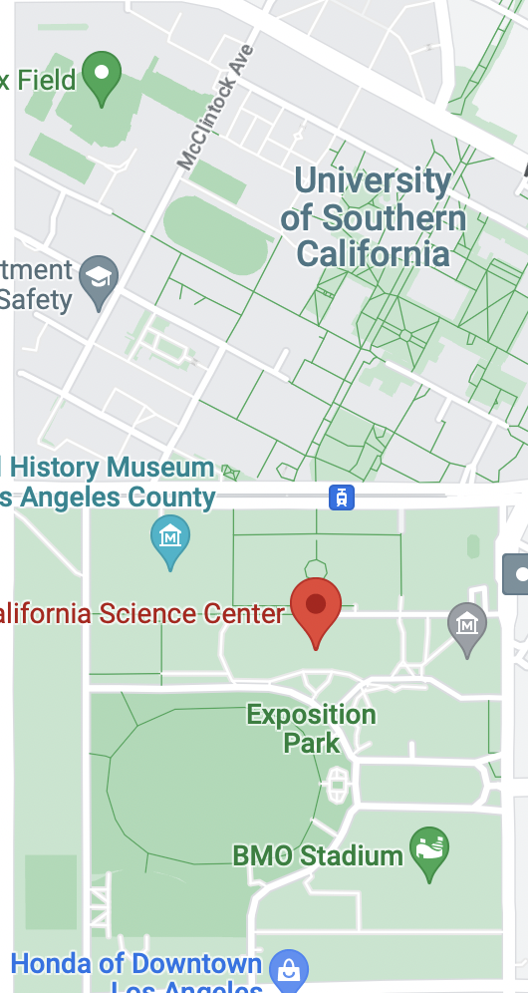
California Science Center
USC to California Science Center
Distance: 1.1 km
Duration: 2-3 hrs
18 min walk
Rating: 4.5/5 (Tripadvisor)

Slide 17
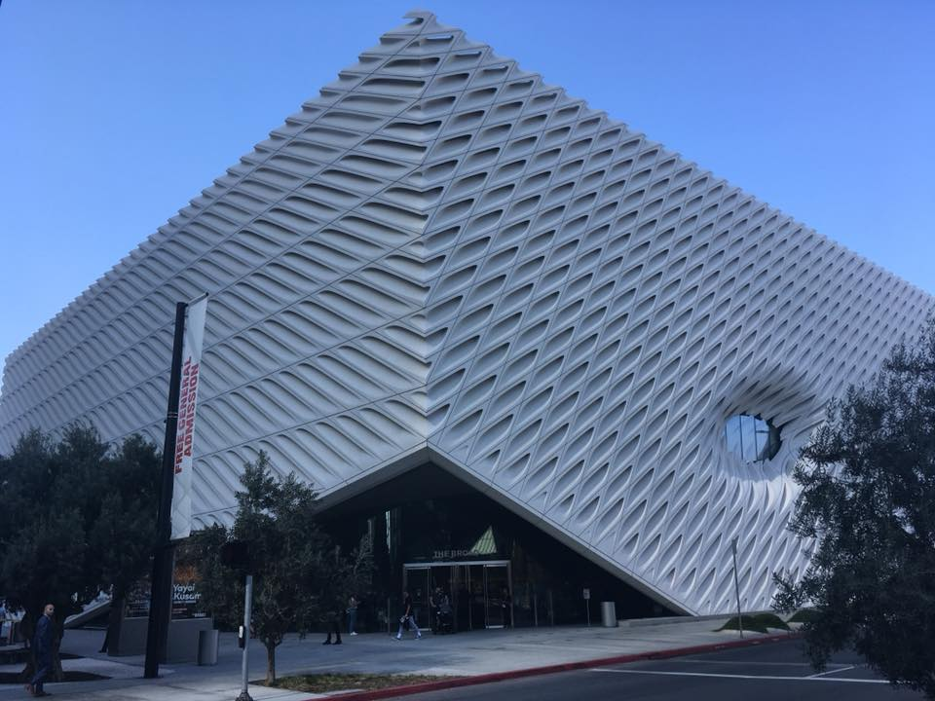
The Broad
A contemporary art museum on Grand Avenue in Downtown Los Angeles. The museum is named for philanthropists Eli and Edythe Broad, who financed the $140 million building that houses the Broad art collections.

Slide 18
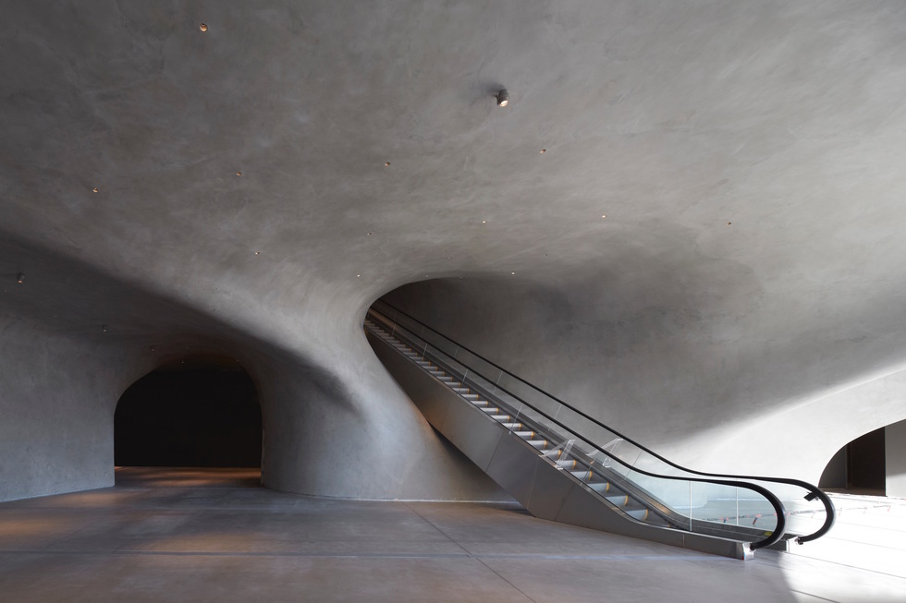
The Broad
Free general admission to its permanent collection galleries
Nearly 2,000-piece collection of contemporary art featuring 200 artists
The museum includes a free-standing restaurant on its plaza, Otium – Latin for "leisure time" – which Eli Broad developed with Bill Chait of République and Bestia restaurants

Slide 19
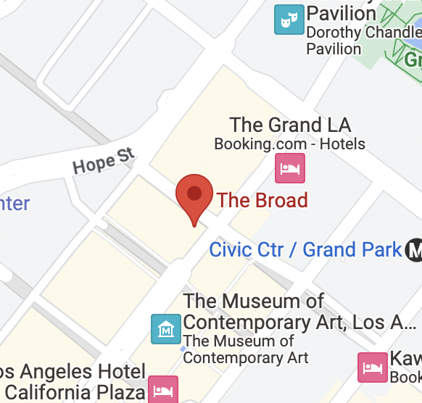
The Broad
USC to The Broad
Distance: 5.2 km
Duration: 1-2 hrs
11 min drive
Rating: 4.5/5 (Tripadvisor)

Slide 20
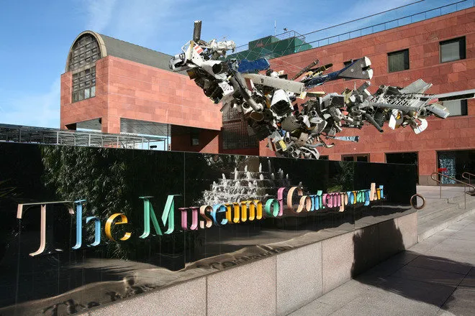
The Museum of Contemporary Art
A contemporary art museum with two locations in greater Los Angeles, California. The main branch is located on Grand Avenue in Downtown Los Angeles, near the Walt Disney Concert Hall. MOCA's original space, initially intended as a "temporary" exhibit space while the main facility was built, is now known as the Geffen Contemporary, in the Little Tokyo district of downtown Los Angeles.

Slide 21
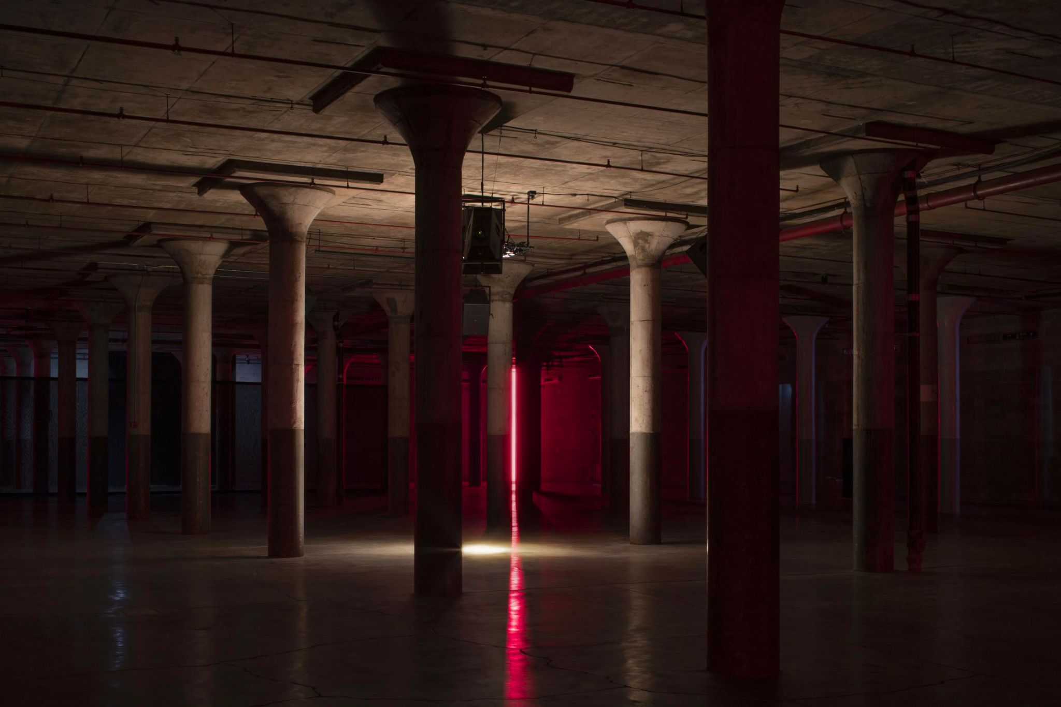
The Museum of Contemporary Art
Established in 1979, MOCA is the only artist-founded museum in Los Angeles. It dedicated to collecting and exhibiting contemporary art. It house one of the most compelling collections of contemporary art in the world, comprising roughly 7,500 objects, and have a diverse history of ground-breaking, historically-significant exhibitions.

Slide 22
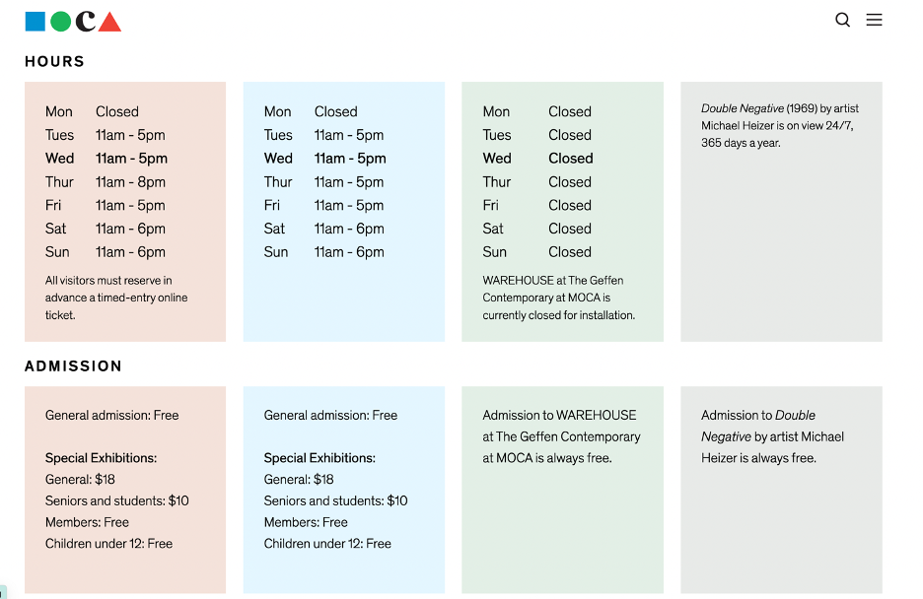
The Museum of Contemporary Art

Slide 23
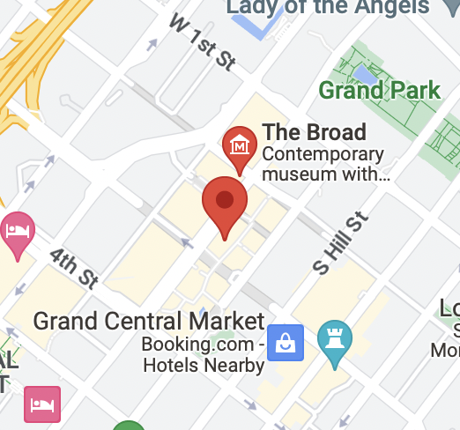
The Museum of Contemporary Art
USC to The Museum of Contemporary Art
Distance: 5.4 km
Duration: 1-2 hrs
12 min drive
Rating: 4/5 (Tripadvisor)

Slide 24
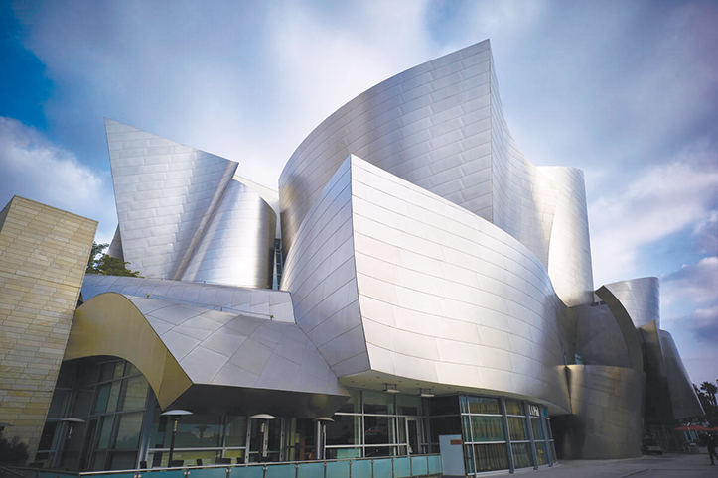
Walt Disney Concert Hall
Designed by Frank Gehry
Architectural landmark
One of the most acoustically sophisticated concert halls in the world

Slide 25
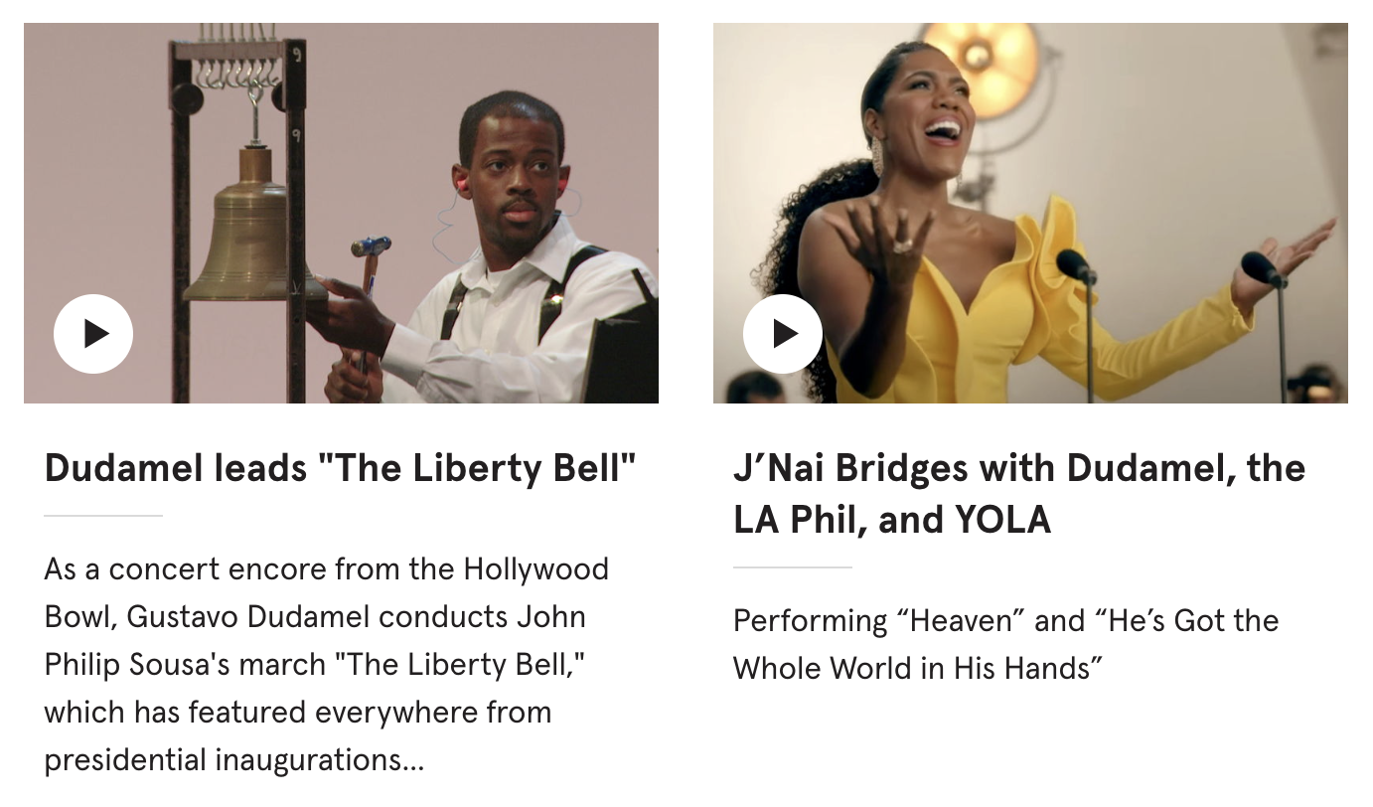
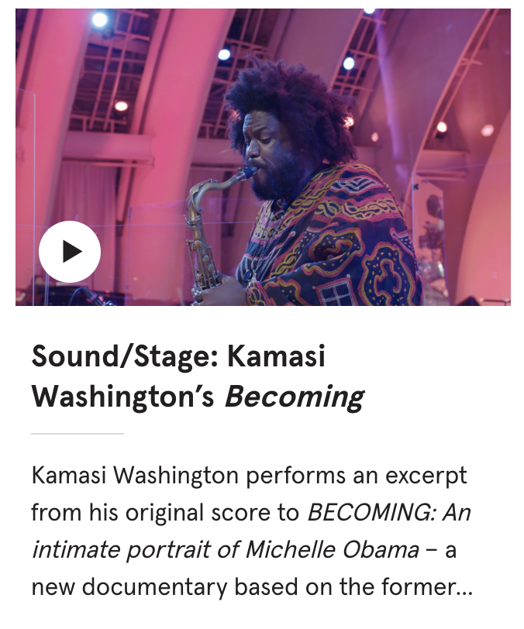
Walt Disney Concert Hall
Walt Disney Concert Hall (WDCH) is the home of the Los Angeles Philharmonic, presenting the best in classical music, contemporary music, world music and jazz.

Slide 26
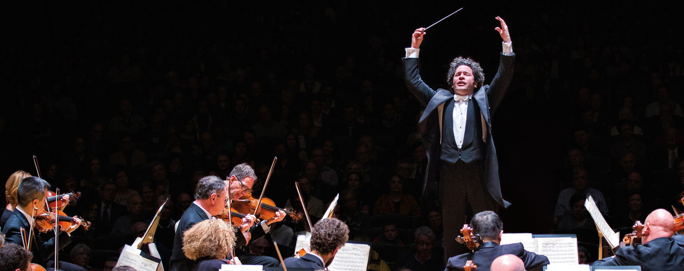
Walt Disney Concert Hall
Founded in 1919, the Los Angeles Philharmonic Association presents, and promotes the performing arts in its varied forms at the highest level of excellence to a diverse and large audience, at Walt Disney Concert Hall, the Hollywood Bowl, and The Ford.

Slide 27
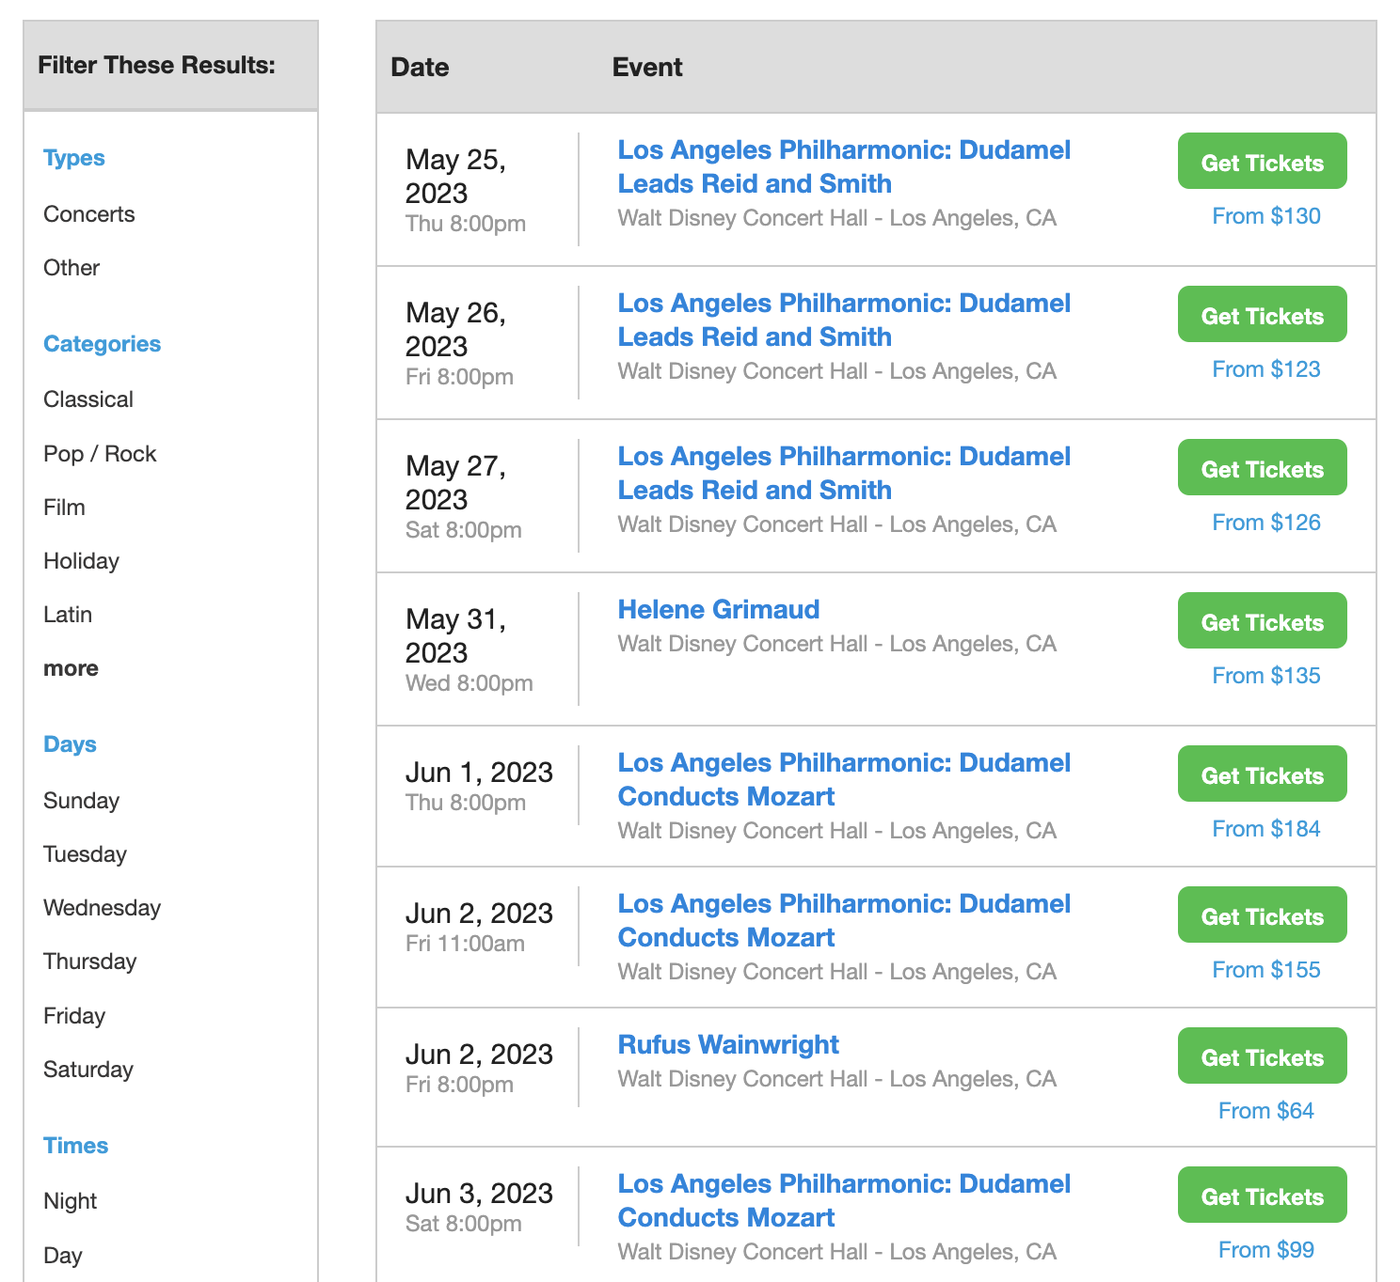
Walt Disney Concert Hall
On average, the cost to attend a live event at Walt Disney Concert Hall is $458.53. Seats located in the back of the venue are always the cheapest option and can cost as low as $55.00 a ticket.

Slide 28
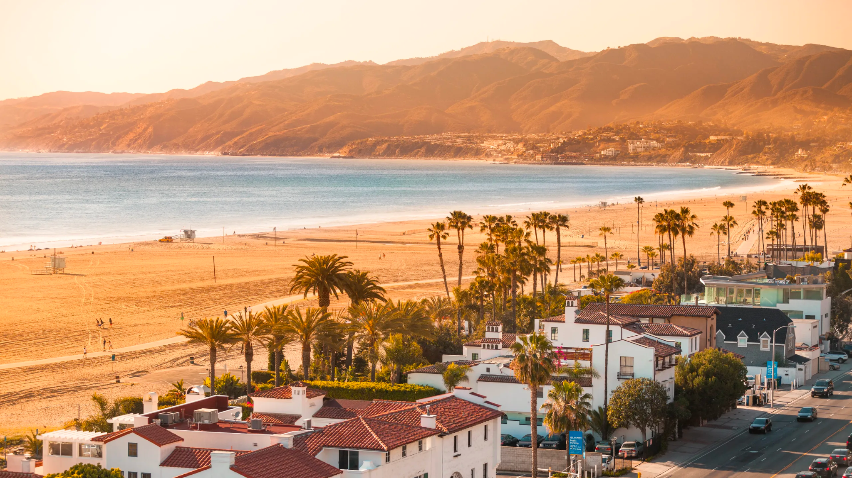
Santa Monica Beach
Located just west of Downtown Los Angeles, Santa Monica Beach is a prime example of the famed Southern California state beaches.

Slide 29
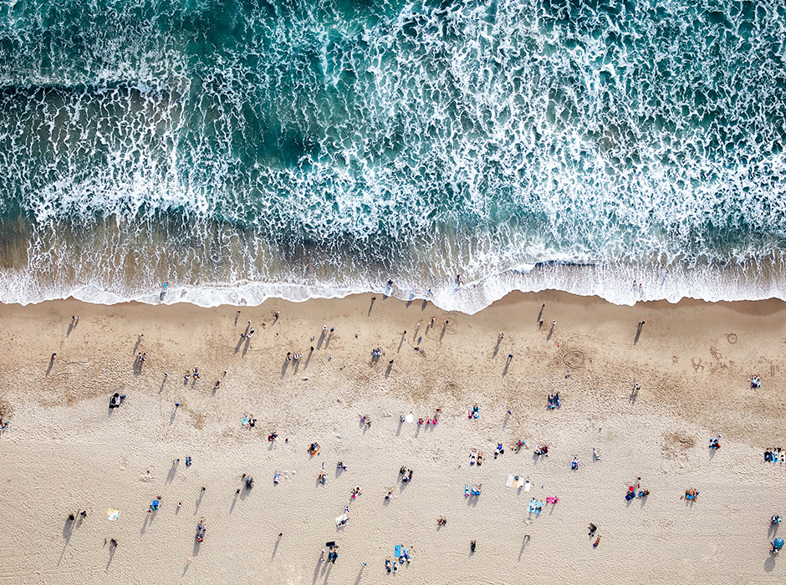
Santa Monica Beach
What can you find at the beach
Plenty of space–3.5 miles long
Soft, sandy shores for little feet
Walkable to hotels, shops and restaurants
Offers a variety of activities and attractions

Slide 30
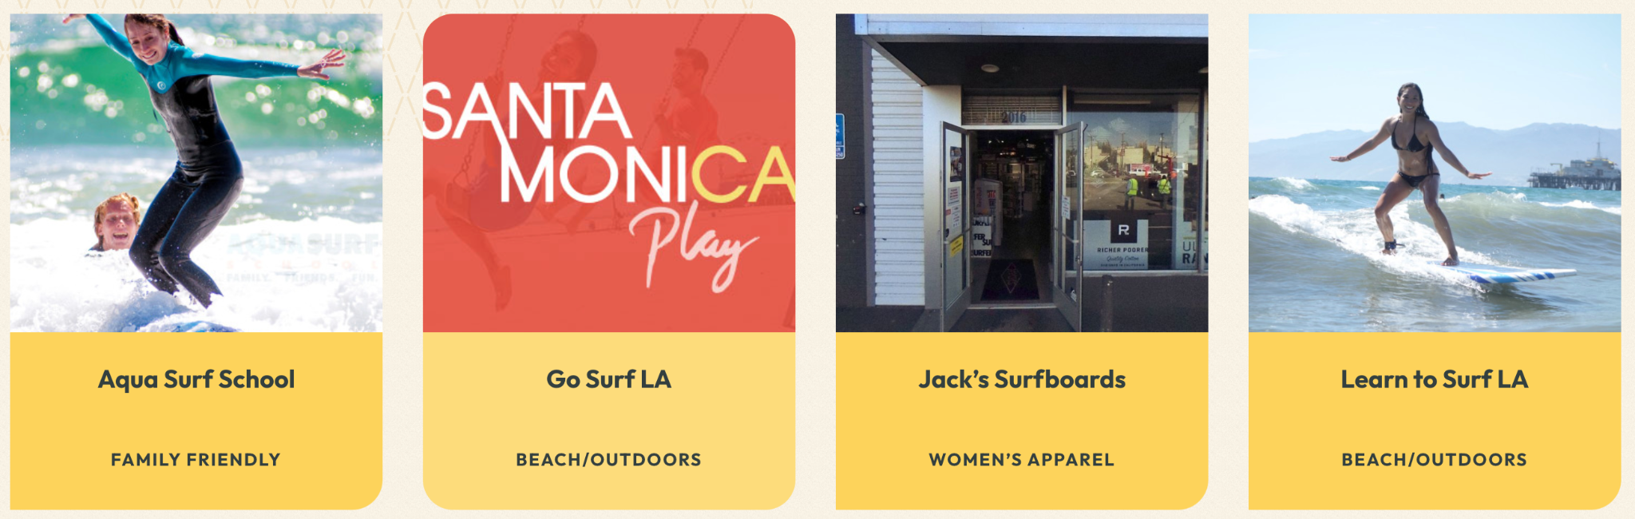
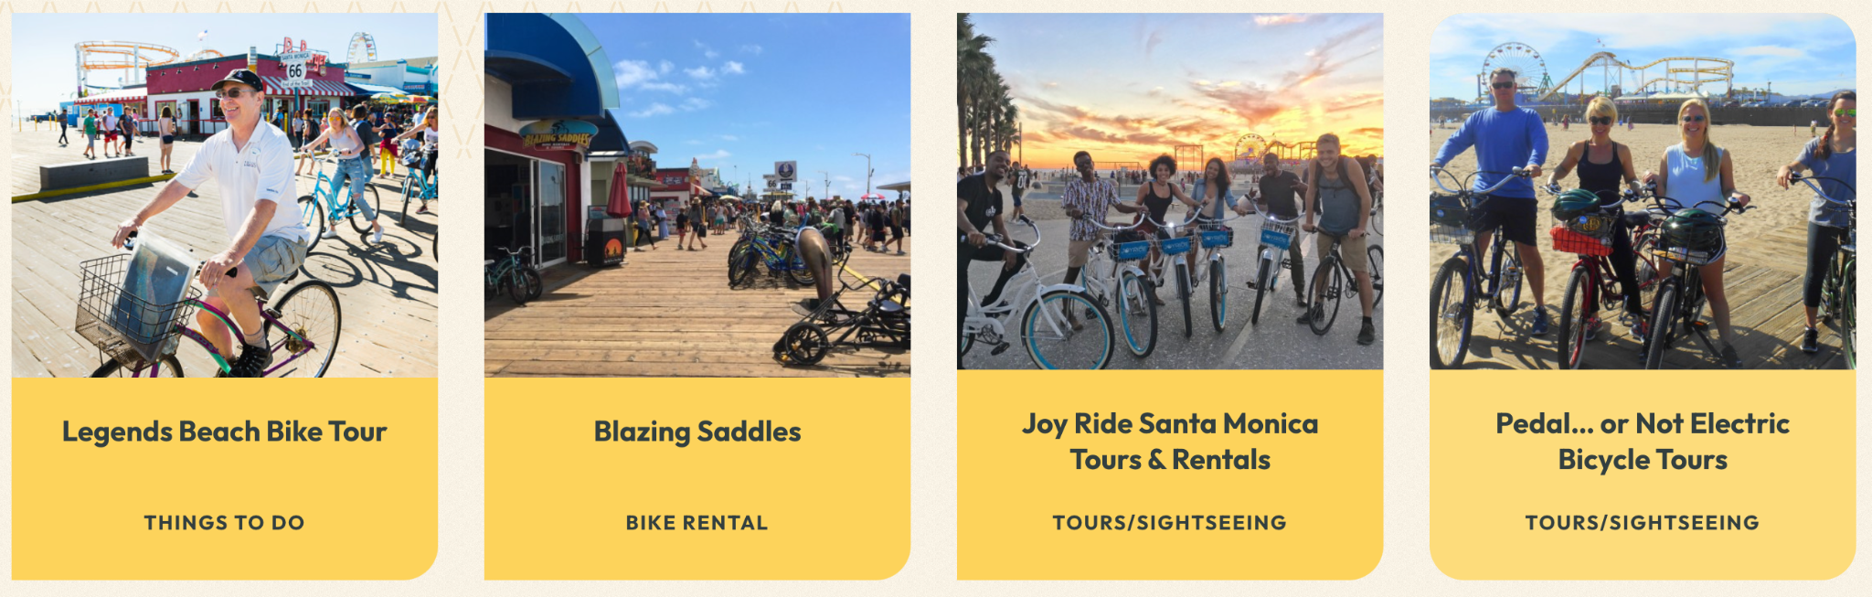
Santa Monica Beach

Slide 31
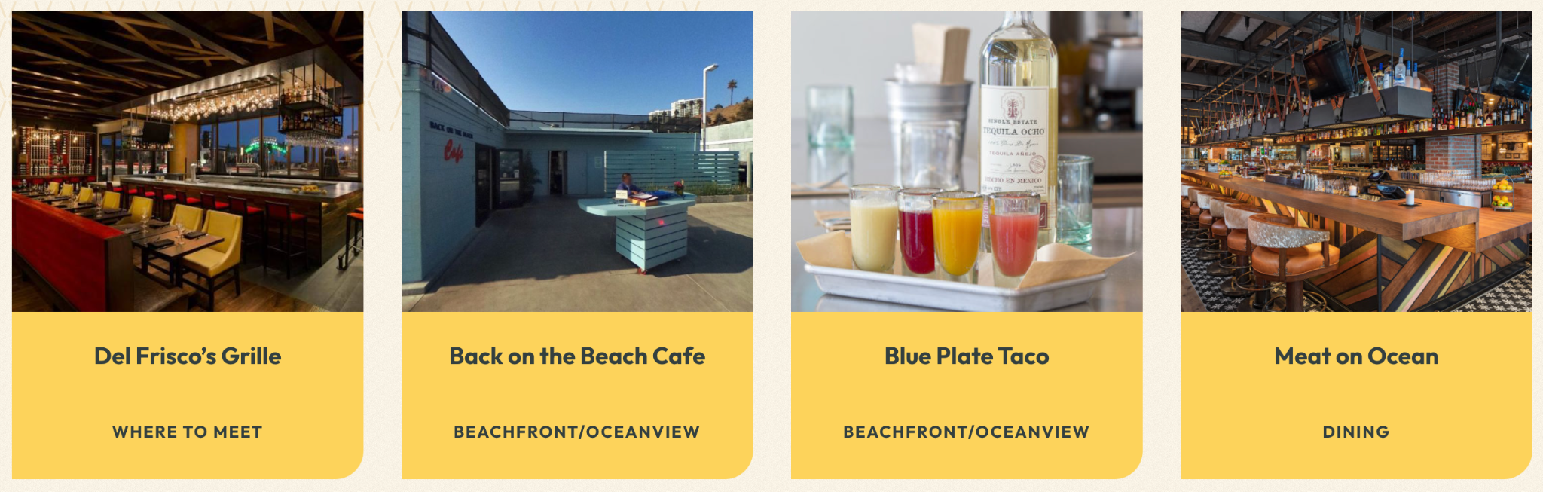
Santa Monica Beach
Picnic areas and parks along the oceanfront walk of the Santa Monica beach are popular spots for locals and tourists. Nearby hotels, the pier and Ocean Ave. and Main St. also offer a variety of restaurants, cuisines, and price points, all within walking distance.

Slide 32
Citation
https://www.laphil.com/about/our-venues/about-the-walt-disney-concert-hall
https://www.ticketsmarter.com/venues/walt-disney-concert-hall
https://www.santamonica.com/things-to-do/santa-monica-beach/
https://www.discoverlosangeles.com/media/facts-about-la
https://simple.wikipedia.org/wiki/Los_Angeles

Slide 33
THANK YOU

